Slide 1
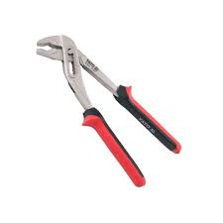
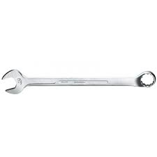
Basic marking cutting hand tools.
1.Water pumps pliers
- It is used for removing and replacing clamps.
2.Spanners
- It is used to for fastening and loosing bolts and nuts.

Slide 2
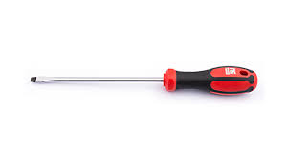
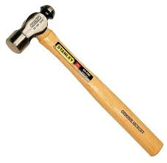
Basic marking cutting, power and hand tools. (continues)
3.Screwdriver
- It is used for fastening and loosing screws.
4.Hammer
- It is used for general hammering.

Slide 3
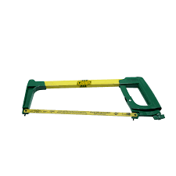
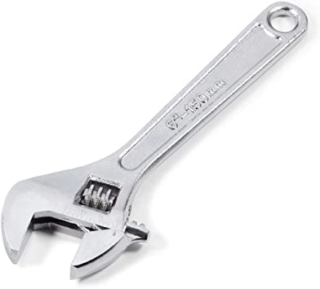
Basic marking cutting hand tools. (cont..)
5.Hacksaw
- It is used for cutting pipes.
6.Shifter
- It is used for fastening and loosening of bolts and nuts.

Slide 4
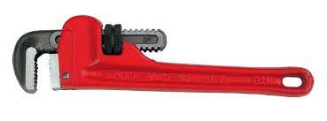
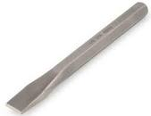
Basic marking cutting hand tools. (cont..)
7.Pipe wrench / Bob Jones
- It is used for fastening and loosening of bolts, nuts and fittings.
8.Chisel
- It is used as a cutting tool..

Slide 5
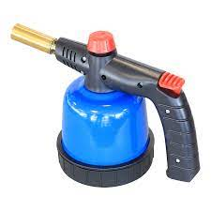
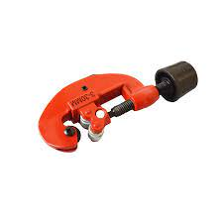
Basic marking cutting hand and power tools. (cont..)
9.Blow torch
- It is used for heating of metals and pipes
10. Pipe cutter
- It is used cutting pipes.

Slide 6
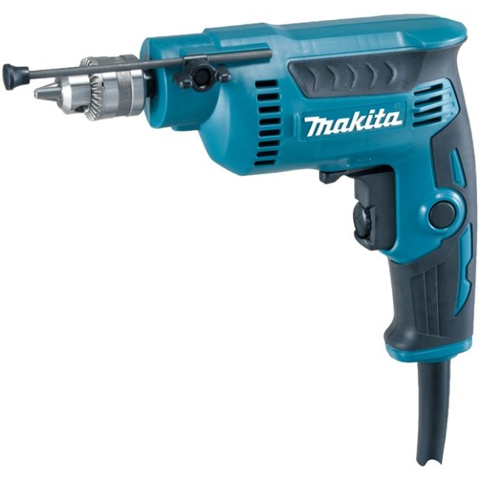
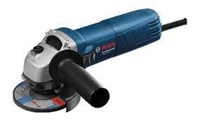
Basic marking cutting and hand tools. (continues)
11.Hand drill
It is used for drilling of materials.
12.Angle grinder
- It is used for cutting and grinding of materials.

Slide 7
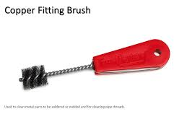
13. Pipe brush
- It is used for cleaning of oxide films.
Video :
https://youtu.be/uppuvS8BShU?si=Sja9O15UfT9SGp3t
Feedback : Activity

Slide 8


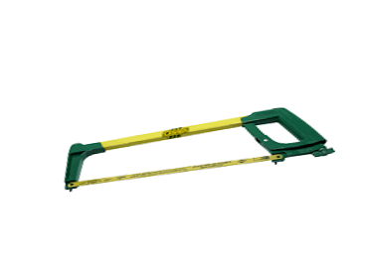

Kwa Thema Skills School
Subject : Maintenance Marks : 10
Grade : Year 1 Time : 30 mins
Date : / / 2024
Question:1
1. Name the following marking and cutting hand tools.
1.__________________ 2.______________________
3.___________________ 4. ______________________

Slide 9
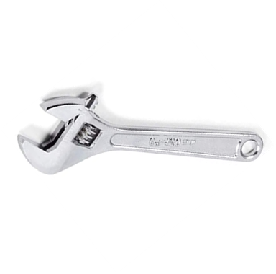
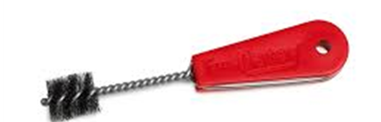




5. _________________ 6. ____________________
7. __________________ 8. ___________________
9. __________________ 10. ___________________
(10)

Slide 10
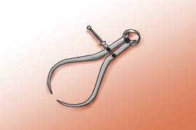
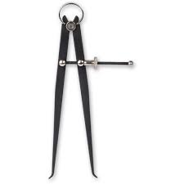
Measuring and Marking of tools
1.Callipers
- There are two types of callipers i.e. inside and outside callipers.
- They are use to determine shorter lengths.
Outside Calliper
Inside Calliper.

Slide 11
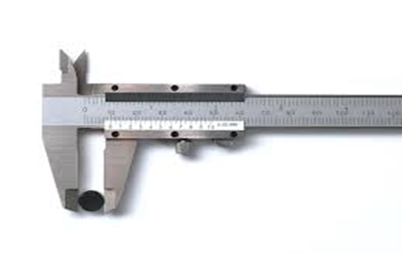
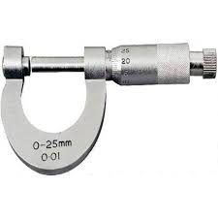

2.Vernier
-It is used to measure lengths.
3.Screw gauge (Micrometer)
-It is used to measure precise small lengths.
4.Measuring tape.
It is used to measure lengths.
Feedback : Activity

Slide 12
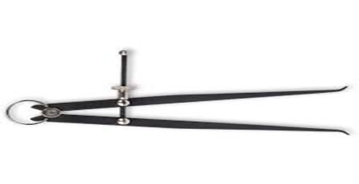
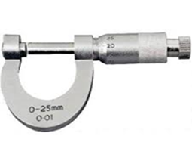



Kwa Thema Skills School
Subject : Maintenance Marks : 10
Grade : Year 1 Time : 30mins
Date : / /2024
Question:1
1.Name the following marking and measuring hand tools and its purpose or use.
No | Picture | Name | Purpose or Use
1 |  | _____________ | ___________________________________
2 |  | _____________ | ___________________________________
3 |  | _____________ | ___________________________________
4 |  | _____________ | ___________________________________
5 |  | _____________ | ___________________________________

Slide 13
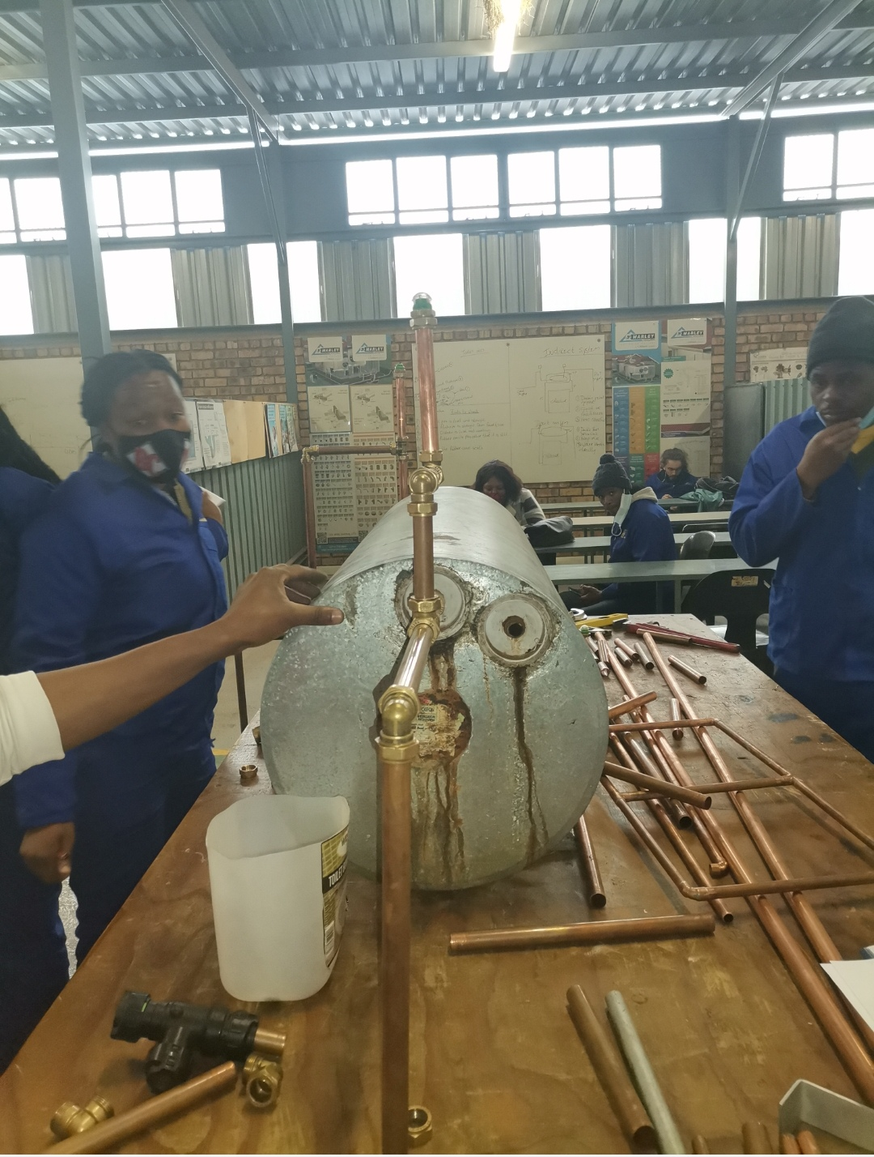
Feedback : Activity
(Practical lesson or Project)
Pipe Fitting

